Slide 1
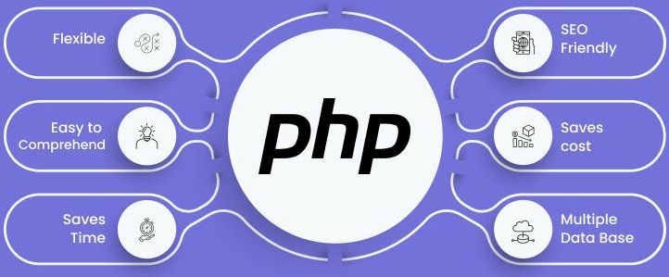

Slide 2
About today…
MySQL
CRUD Operations
Performing CRUD operations in PHP

Slide 3





Introduction to CRUD Operations

Slide 4
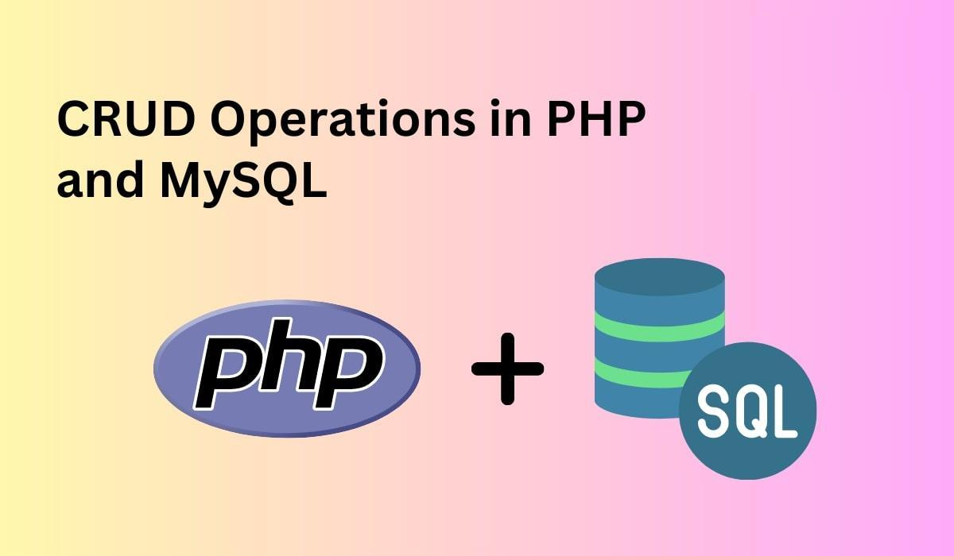

Slide 5
The Power of CRUD Operations
Essential tools for web applications to interact with databases
Enable the creation of dynamic and data-driven web experiences
CRUD operations
form the foundation for a variety of applications
E-commerce
Create product listings
Manage user accounts
Process orders
Social Networking
Create and edit blog posts
Manage user roles
Content Management Systems (CMS)
Create profiles
Post updates
Interact with other users

Slide 6
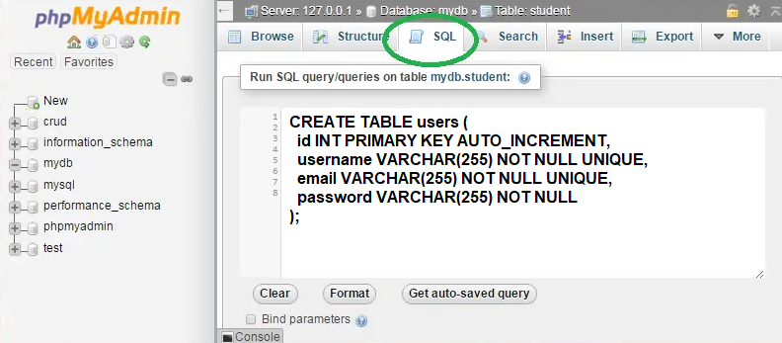
Creating table

Slide 7


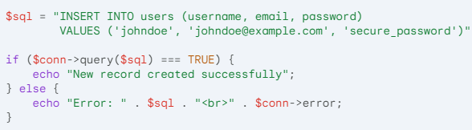
The Create Operation (INSERT)
The INSERT statement adds a new record to a MySQL table
SQL
PHP

Slide 8


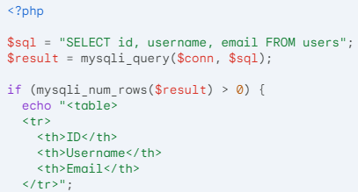
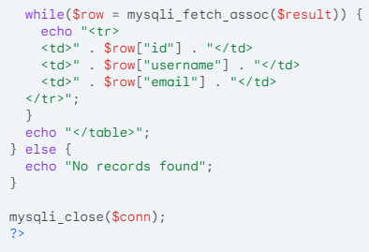
The Read Operation (SELECT)
The SELECT statement retrieves data from a MySQL table
SQL
PHP

Slide 9


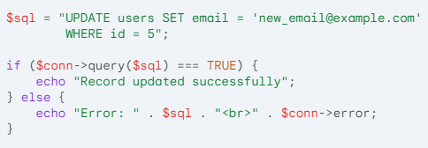
The Update Operation (UPDATE)
The UPDATE statement enables you to modify specific values in existing records
SQL
PHP

Slide 10


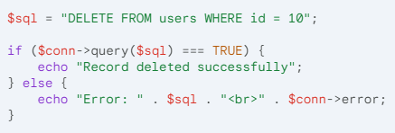
The Delete Operation (DELETE)
The DELETE statement allows you to permanently remove records from a table
SQL
PHP

Slide 11


Slide 12

CRUD stands for what?
What parameters are required to make the connection of PHP with MySQL?
How can you retrieve all records from a MySQL table named products?

Slide 13

Task 1
Create a MySQL table for "books" (title, author). Write PHP code (MySQLi) to: add a new book, list all books, update a book's title, and delete a book (confirm first!)
Task 2
Build a basic webpage (HTML) with a form to add new movies (title, year) and a button to submit. Use PHP to store this data in your MySQL table (using INSERT statement). Display a list of all added movies on the page.

